Slide 1
DES509 Visual Style Guide
Emma Whitfield and Nathan Anderson

Slide 2
Game Concept
A multiplayer game based on Samuel Beckett’s play - ‘Quad’.
Four players navigate a grid in which every time the player turns, they leave a colour trail behind them.
The player’s must not touch the other players’ trail, otherwise their own trail will become shorter.
The players must move on time to a beat playing in the background, similar to rhythm game mechanics, or else they will not be able to move.
The player can pick up items to help themselves, or hurt the competition.
The goal of the game, as of right now, has not been decided upon.

Slide 3
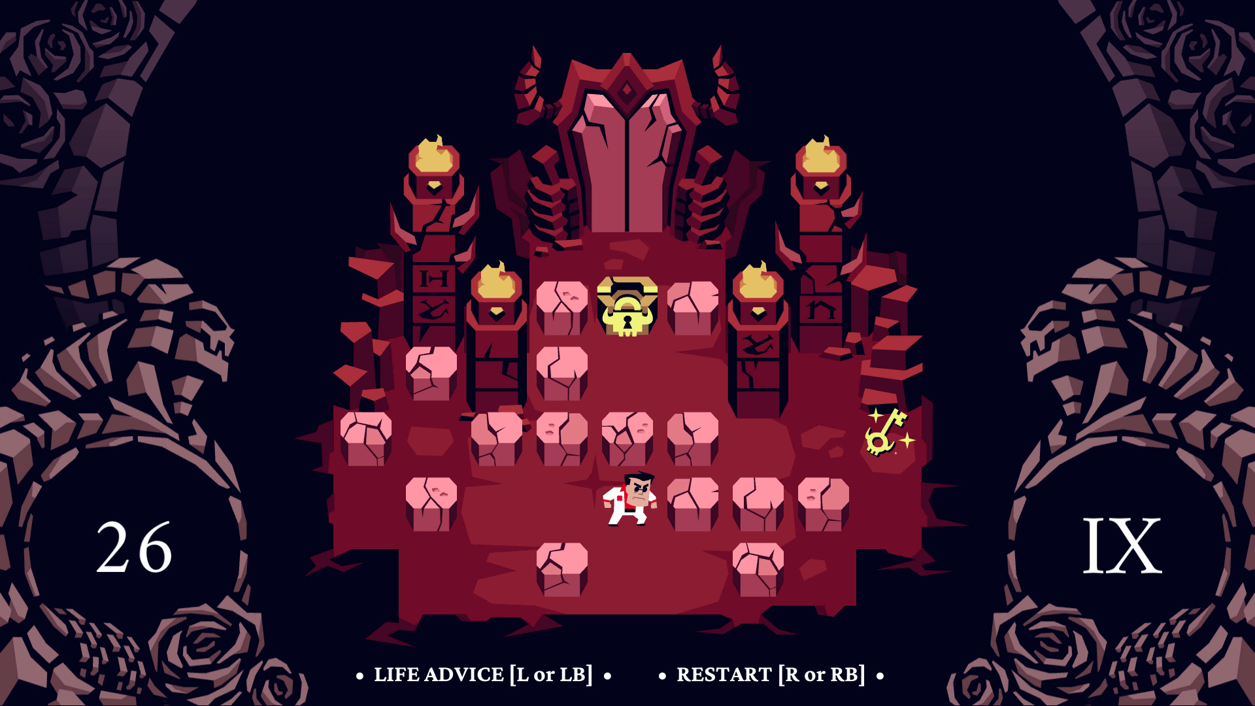
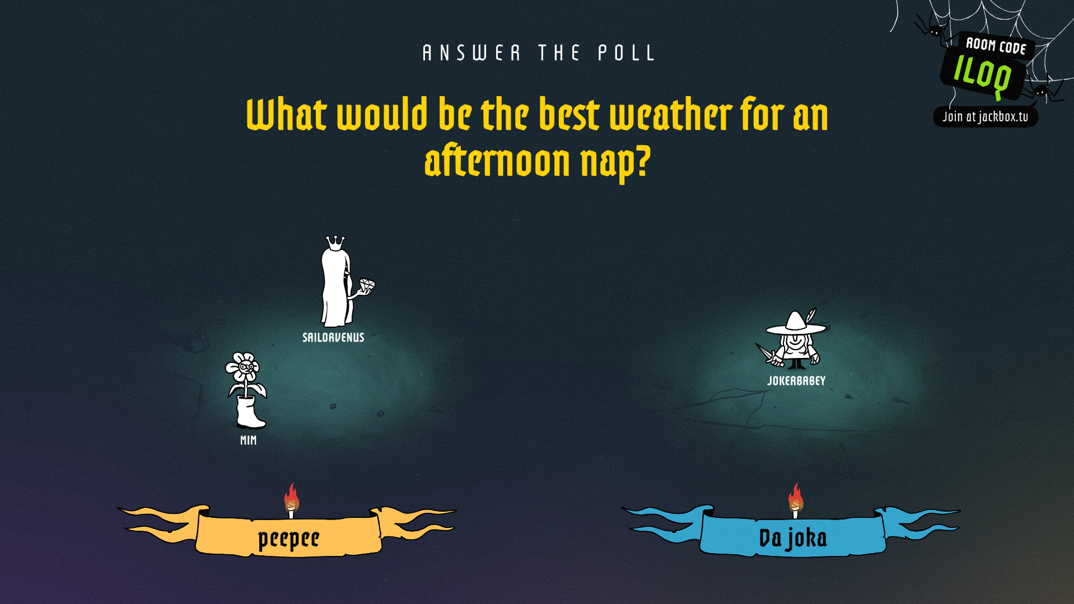
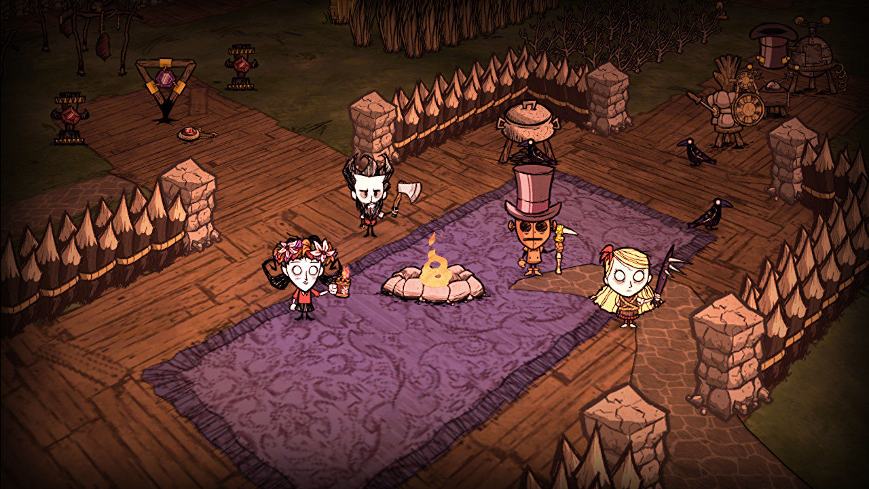
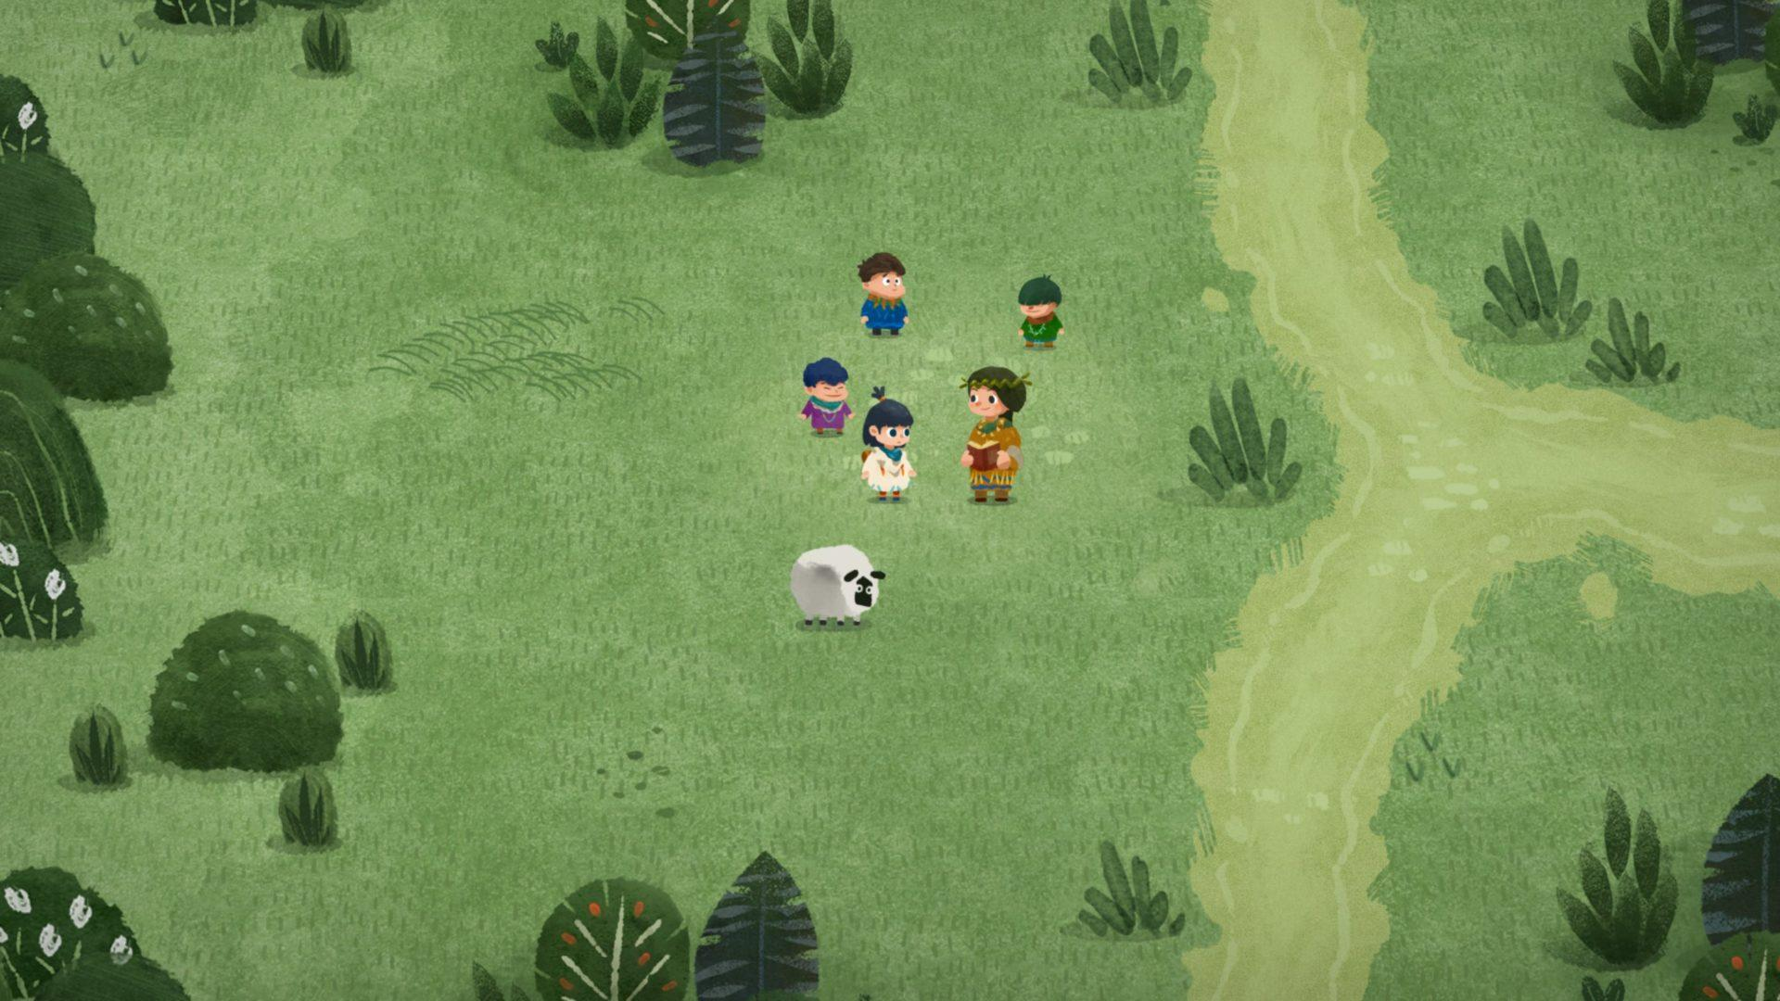
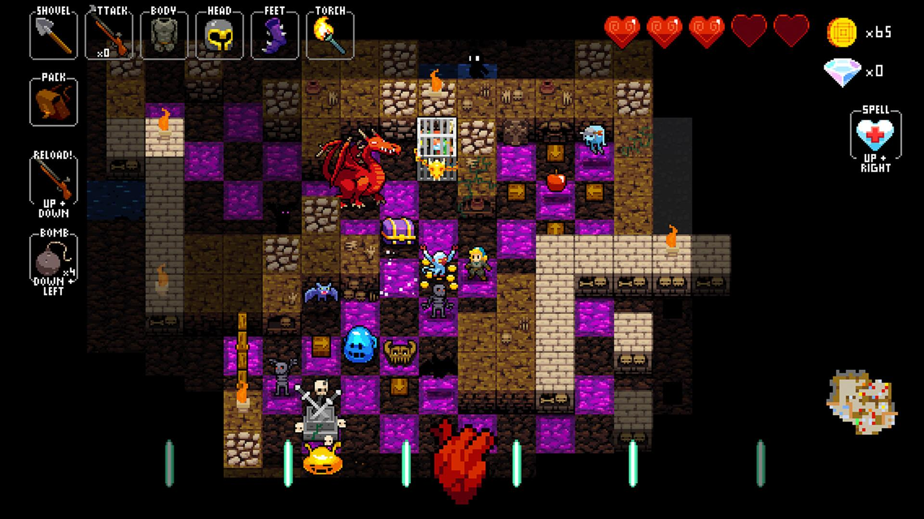
Inspiration
Games that inspired our game visually - 2D isometric views, rhythm games and games that utilise tile sets as well as hand drawn styles.

Slide 4
Visual Principles
The visual principles of the game - the core aesthetics in which our final product should reflect.
Cartoony
Fun
Exaggerated
Colourful
Fun
Bright

Slide 5
Constraints
We will need to create a tile set of assets.
Characters must follow the colour from Quad - Red, Yellow, Blue, White.
Characters identities/gender should be hidden.

Slide 6
UI: Design Elements

Slide 7
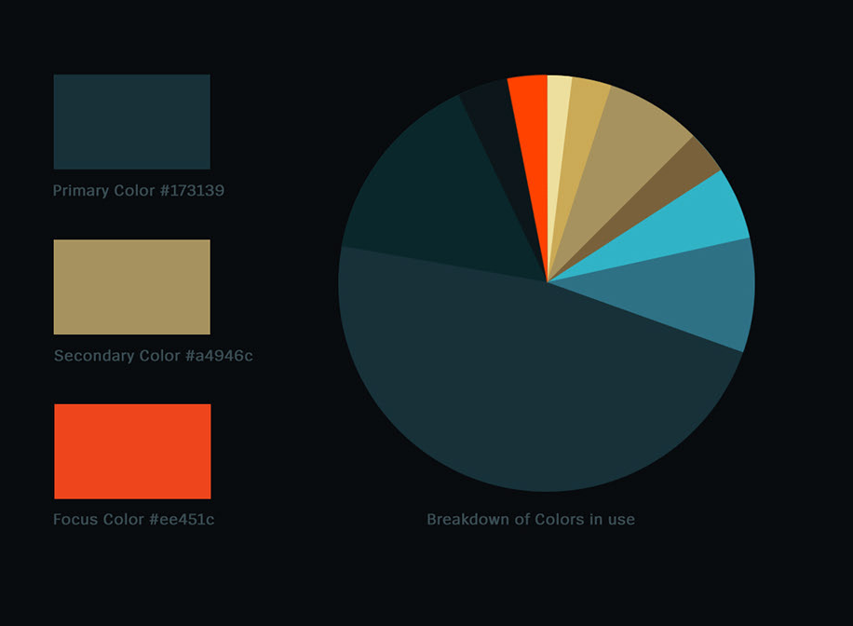
Colour
We split it up, ensure that the U.I. does not clash with other elements by picking colour schemes that fit with the game thematically. Make sure the hex number and a swatch of colour is shown here. Example:

Slide 8
Shapes
Similarly, is the u.i. Round and cute? or sharp and dangerous? in comparison to the other assets.

Slide 9
Rendering
How are we rendering our art? Flat colours? Heavy shading? No highlights? Define it, and show an example (don’t need to spend too long on these examples)

Slide 10
Visual Icons
Any visual icons? E.G. Skull symbols for poisonous items. Plus signs for healing items. Draw them, and define how they look. What colour are they, etc.

Slide 11
Do’s and Don'ts!
Show examples of how to do the UI, and then, examples of how NOT to do the UI.

Slide 12
Character Design

Slide 13
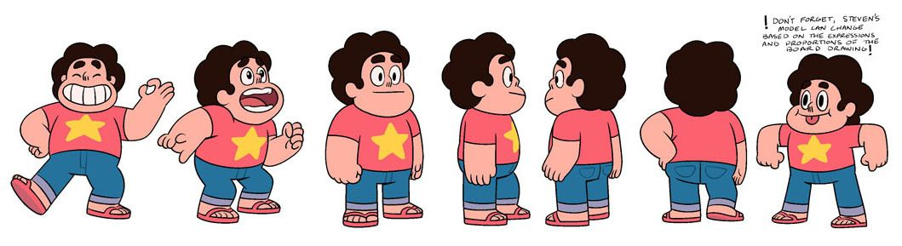
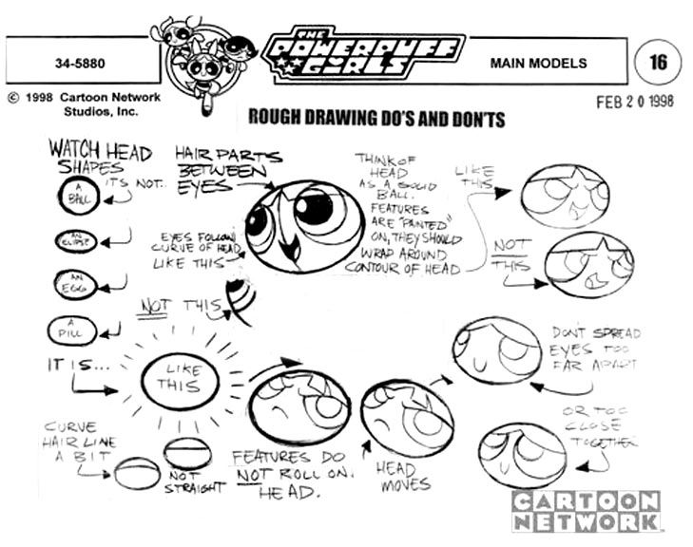
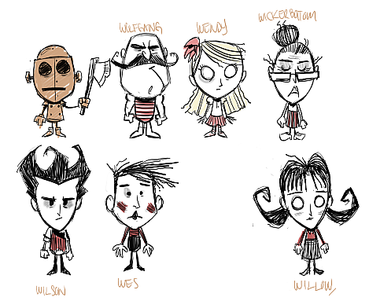
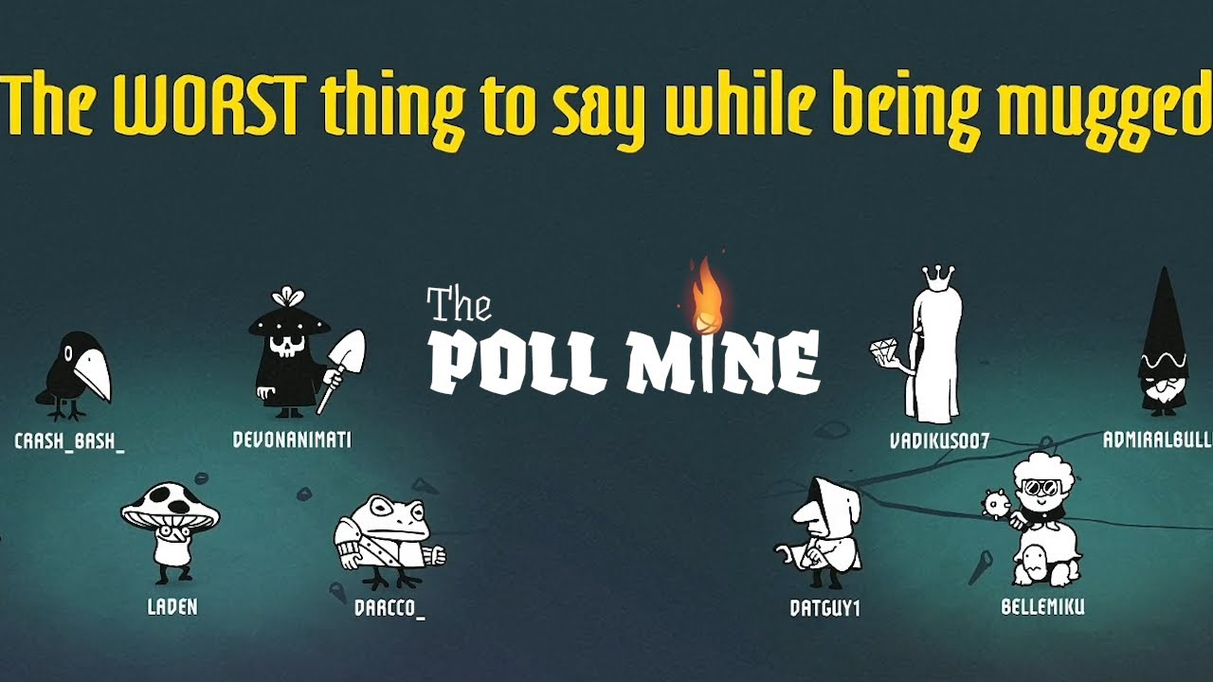
Moodboard
Style inspiration for the characters - Simple and readable designs with a fun, cartoony aesthetic and exaggerated shapes.

Slide 14
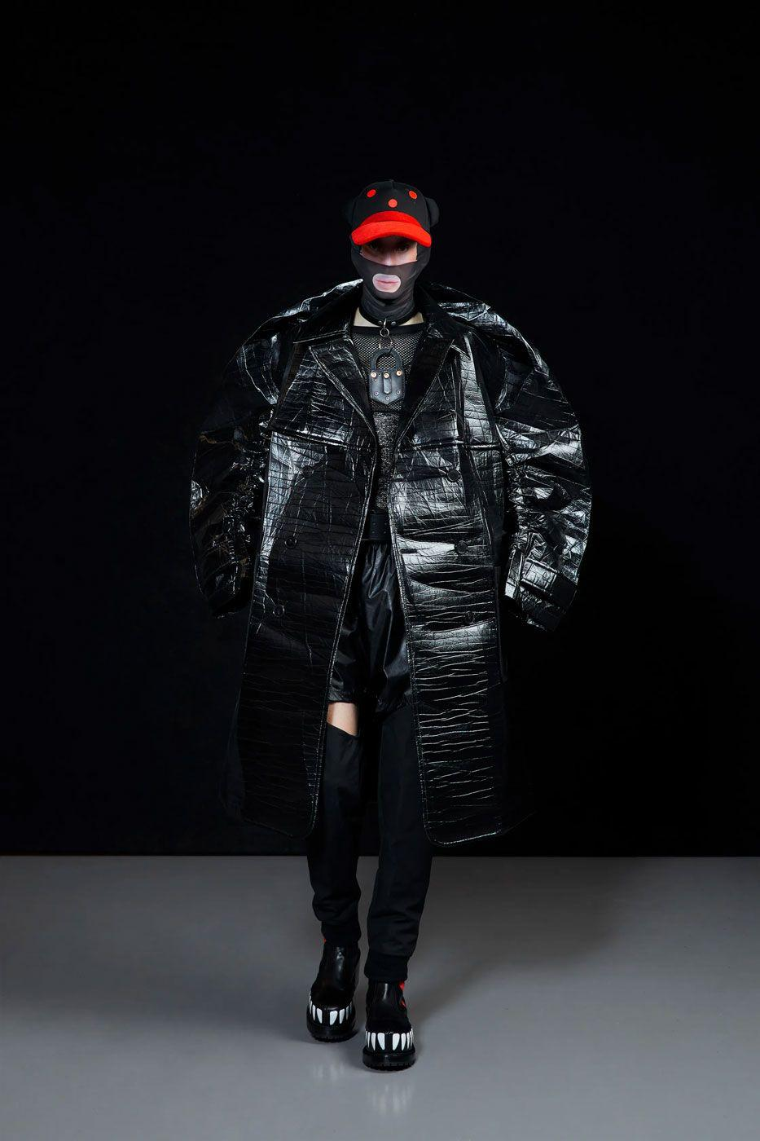
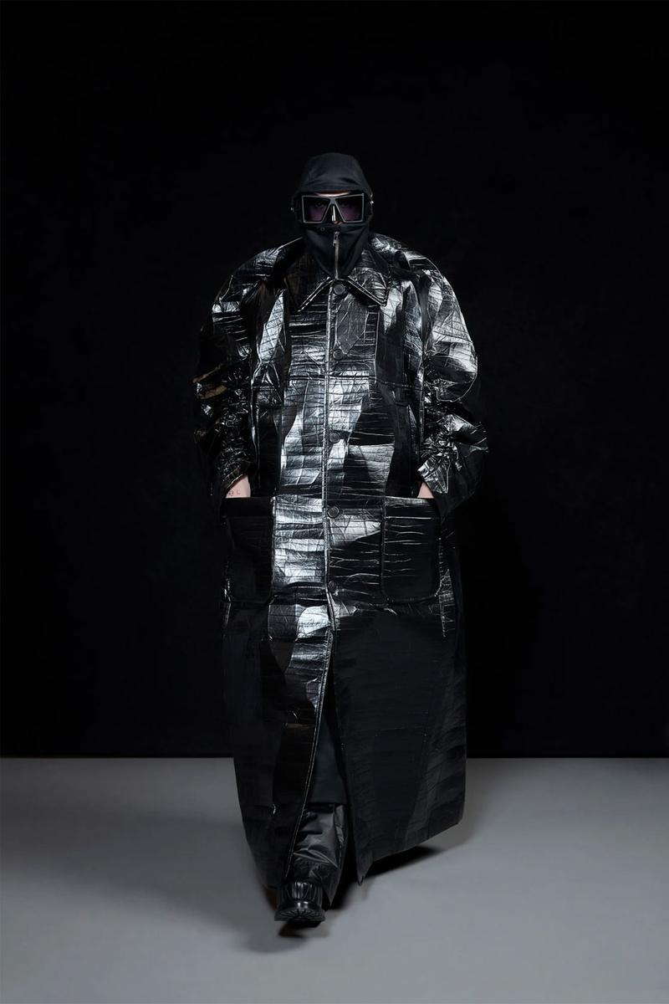
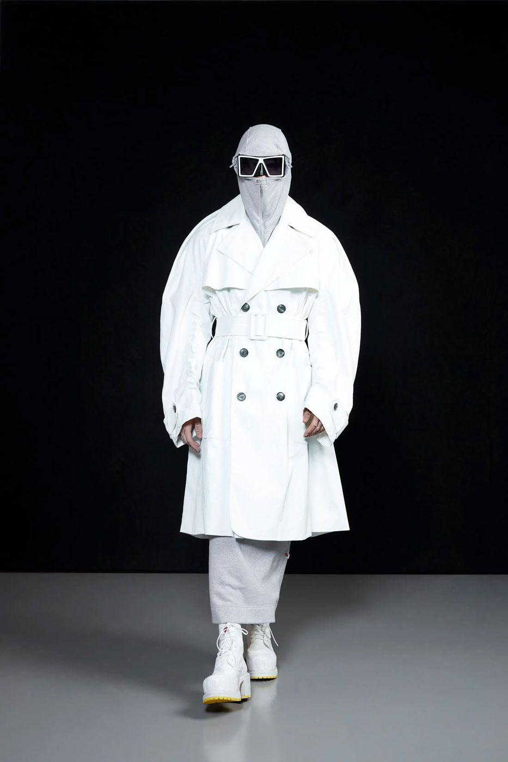
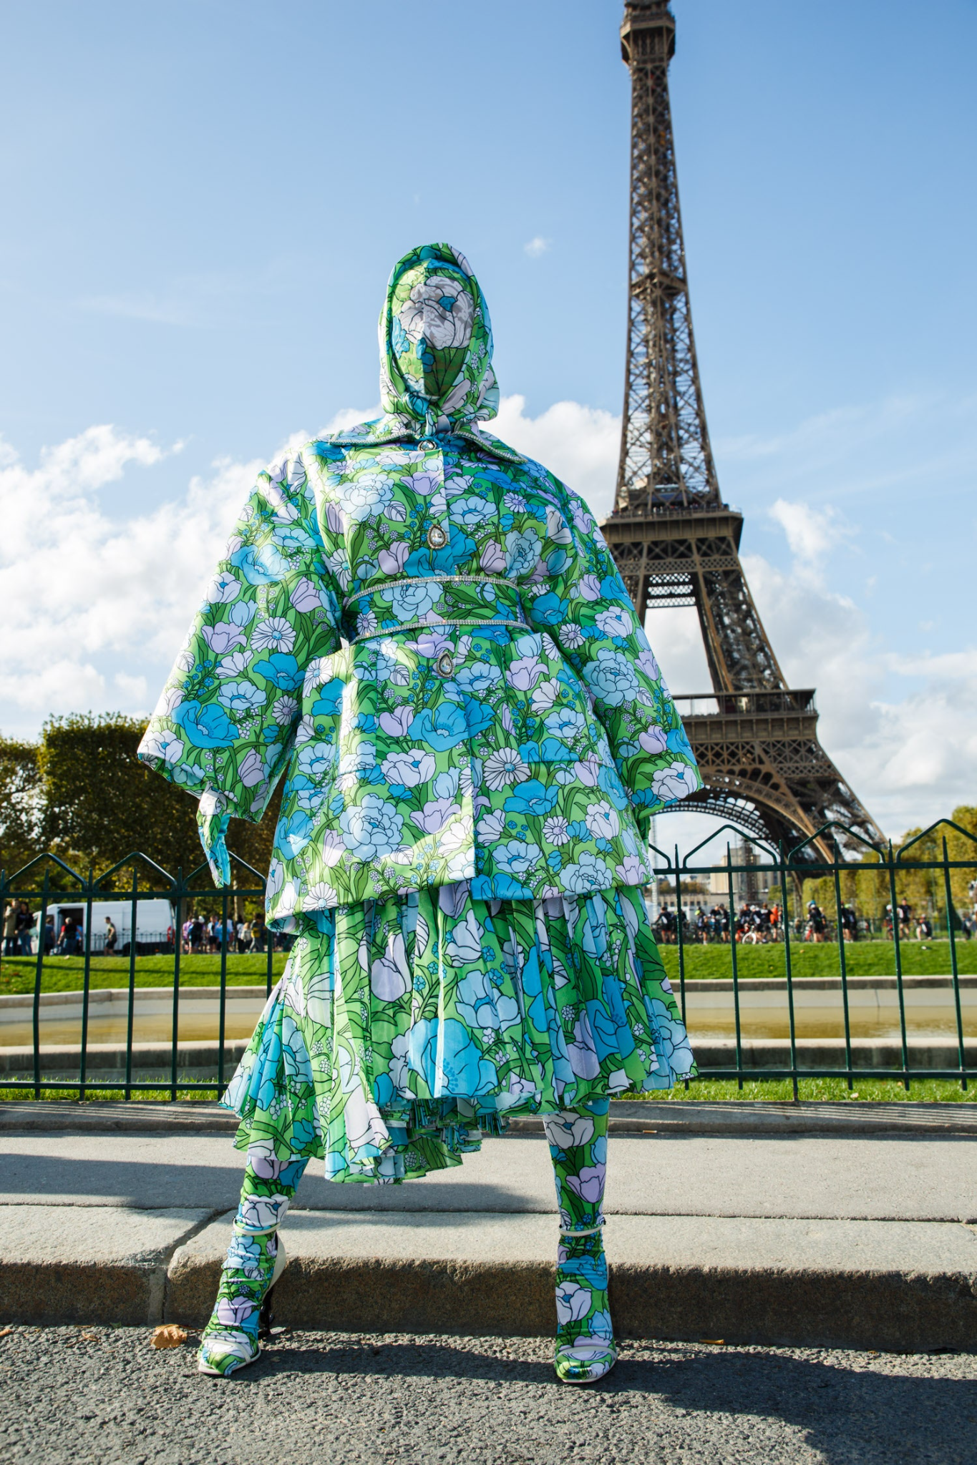
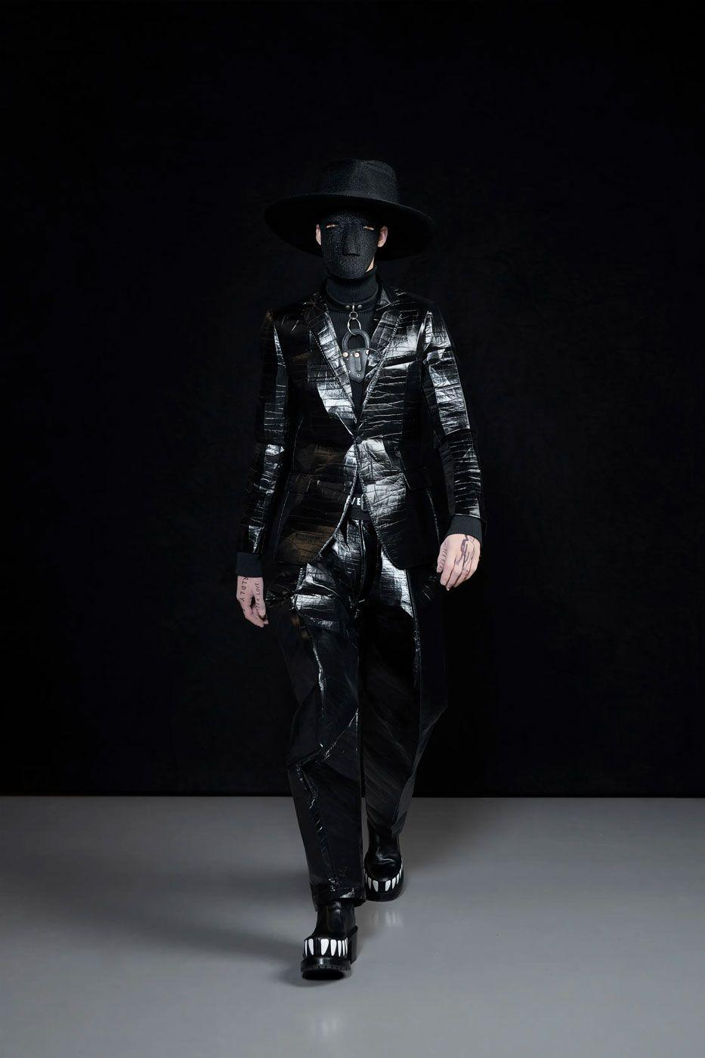
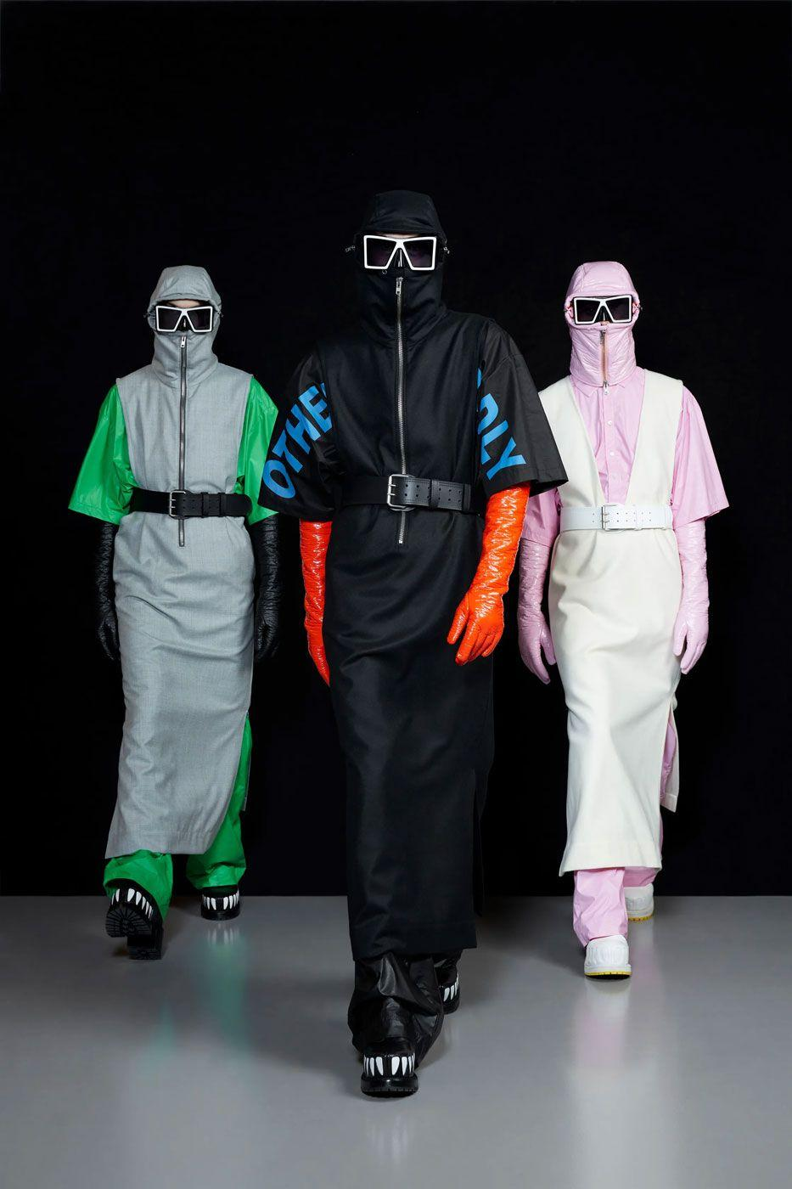
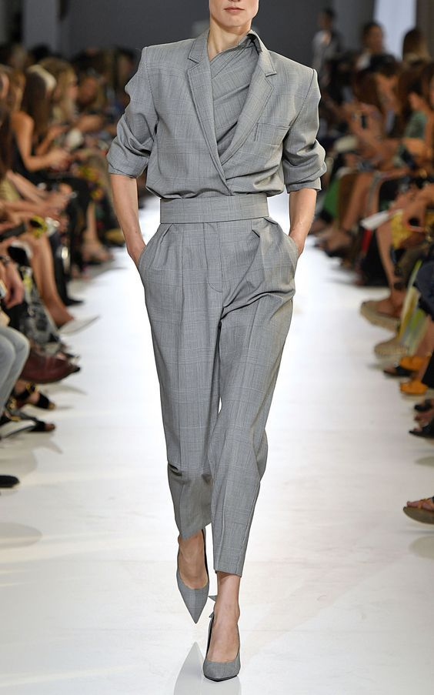
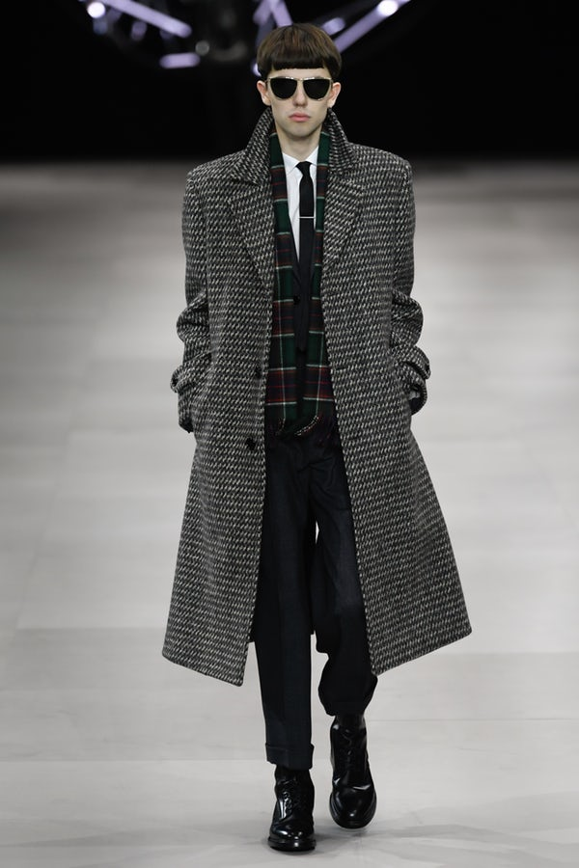
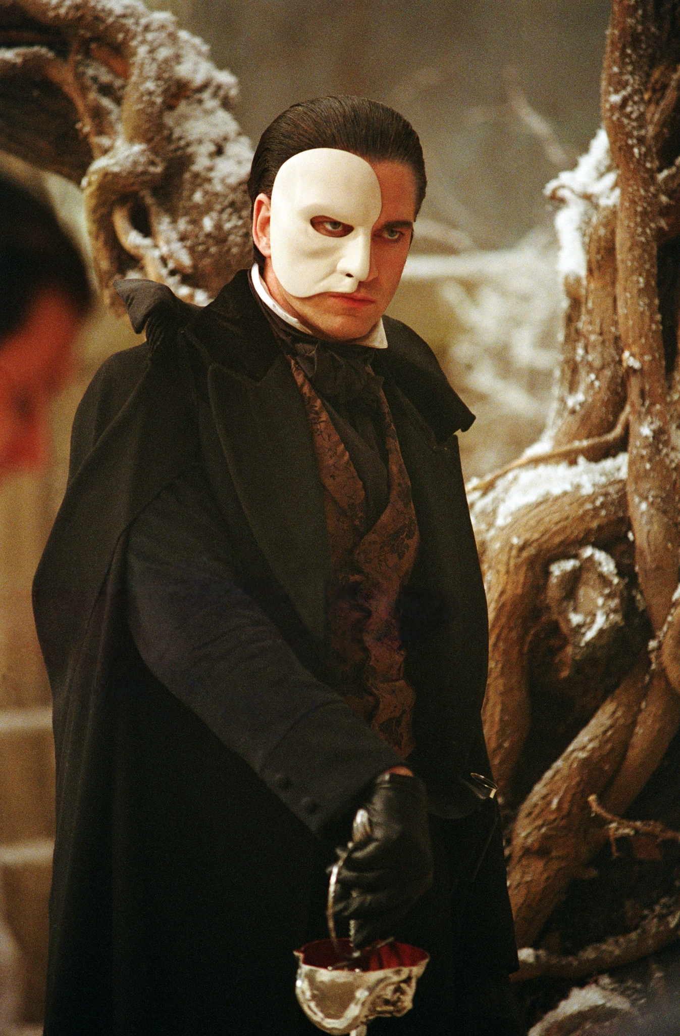
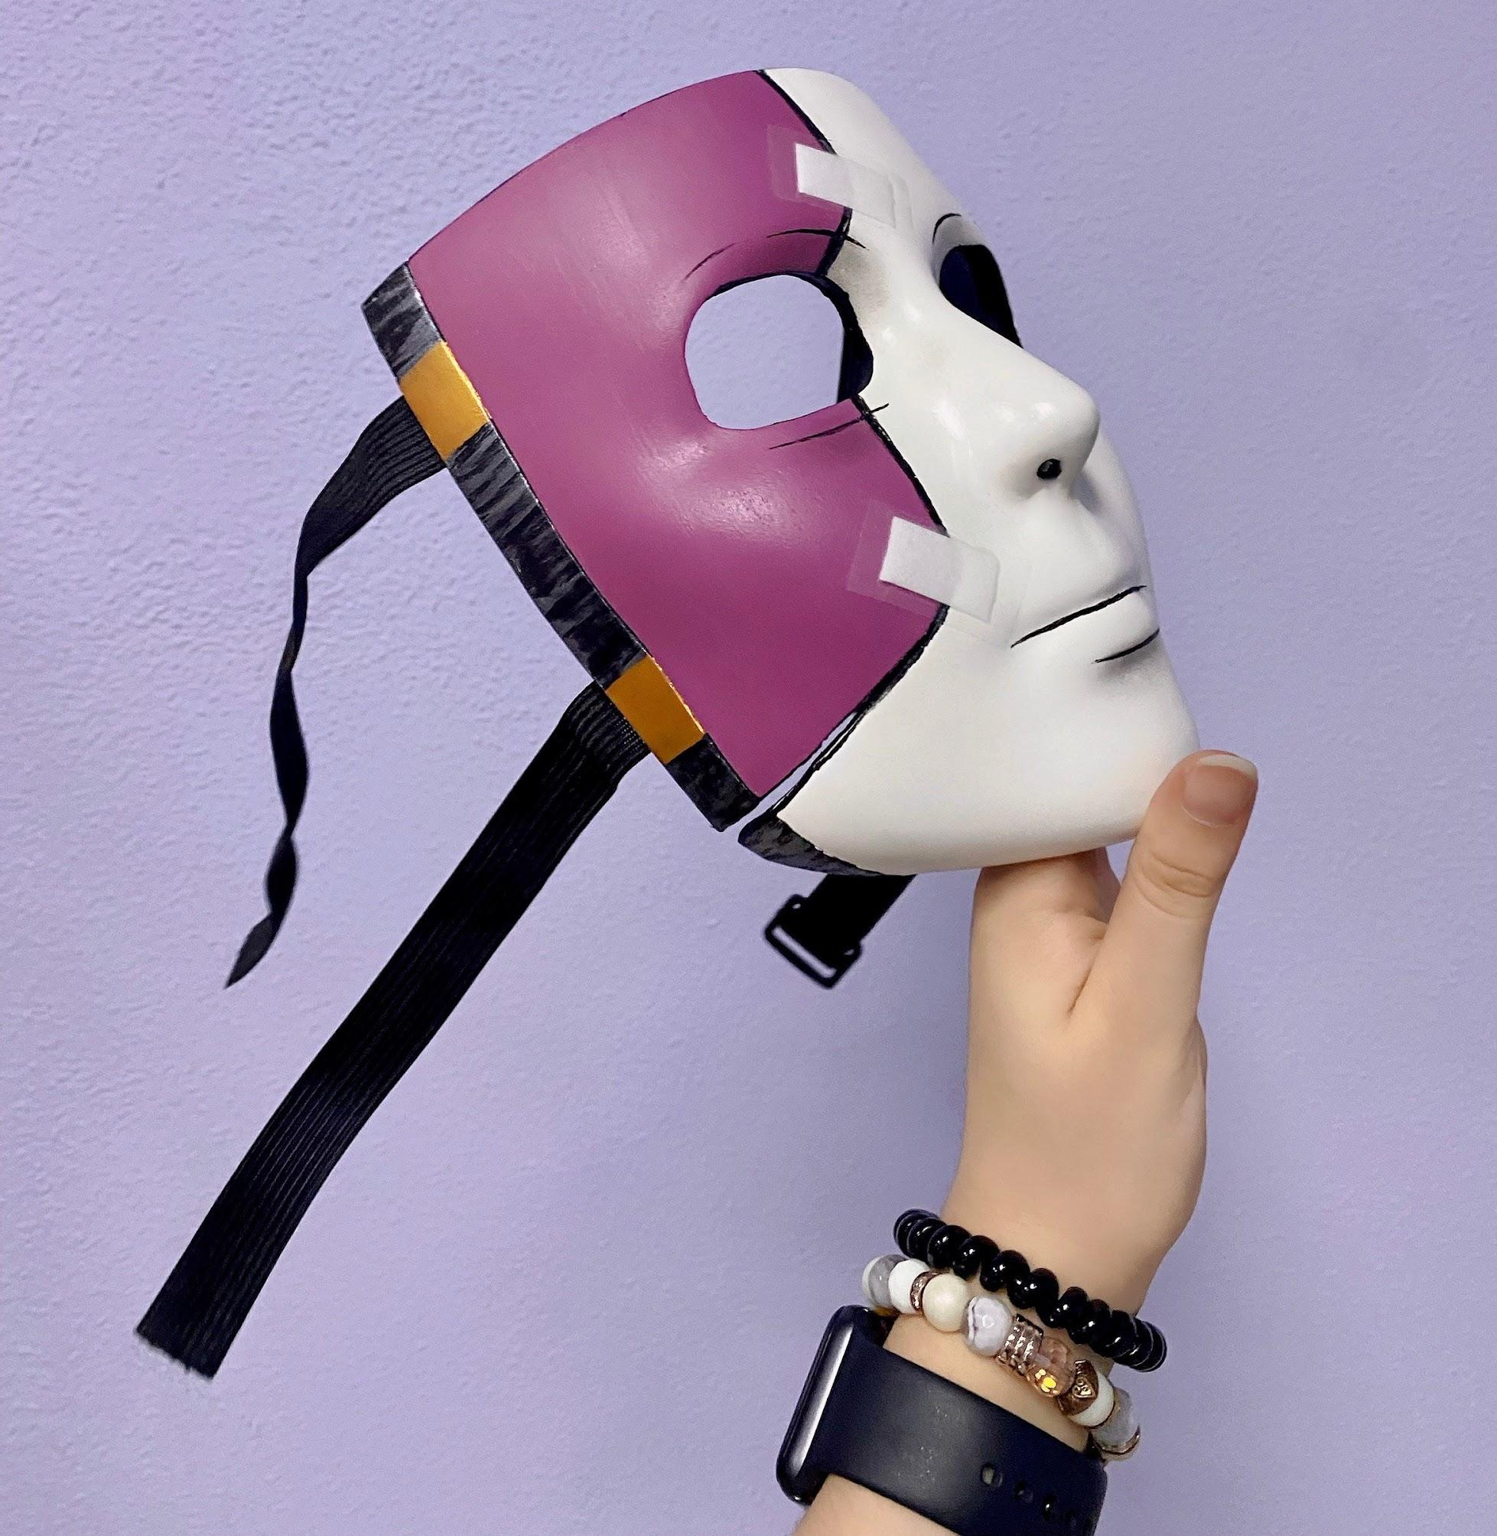
Reference Images
Outfit inspiration using the concepts of ‘hidden identity’ and ‘office attire’.

Slide 15
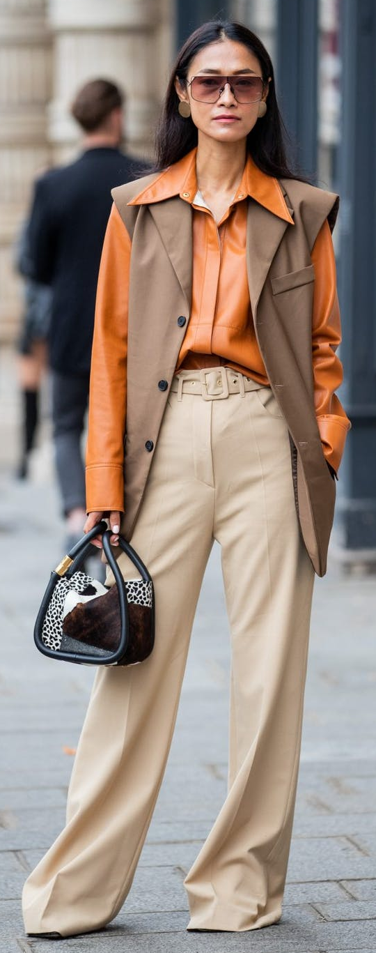
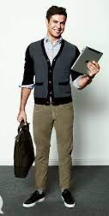
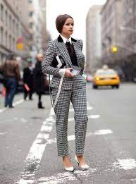
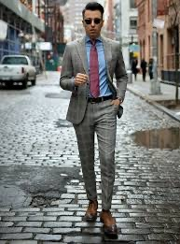
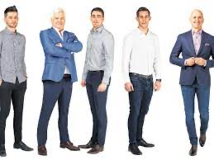

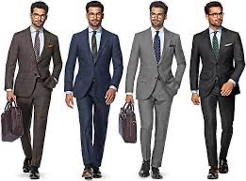
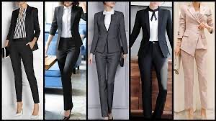
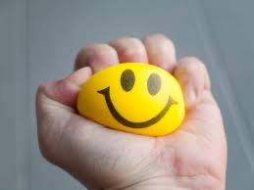
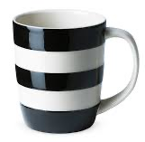
Reference Images

Slide 16
Identity
How to hide your body type; Oversized clothes. Shapes over body. Paint. Hoodie. Different patterns. Walking in a different way
Hide your hair; Hair spray; odd patterns/ shapes, Hats; caps, witch, superhero, ears. Texture on it; goo, slime, food. Cloak. Hoodie. Material
How to identify someone;
Gender; male female, characteristics; hair, face, nails. Body shape. Fashion. Race. Speech. Body language. Communication. Motions> Religion. How to change your identity. Change your persona. Act like someone else. Hide your face. Wear a costume. Wear a mask
Ways to hide your face;
Faceless, Sleep mask, covid 19 mask, drag queen masks, can use handbags as a mask, techy face masks, gas mask, pop culture masquerade masks, zoro mask, adding head gear that works downwards from your hair, gill like masks, facial hair, face paint, mirrored 80s mask, half face; like 2 face, bank robber style, the joker face masks, phantom masks, wrestler mask, incognito fashion shoes, tights over face, steampunk gas masks, cloaks, cyborg mask, tape distorting face, superhero mask, gothic accessories, futuristic glasses, sunglasses, caps, hats, holding something over parts of face, clothing over face; mouth and eyes cut out.

Slide 17
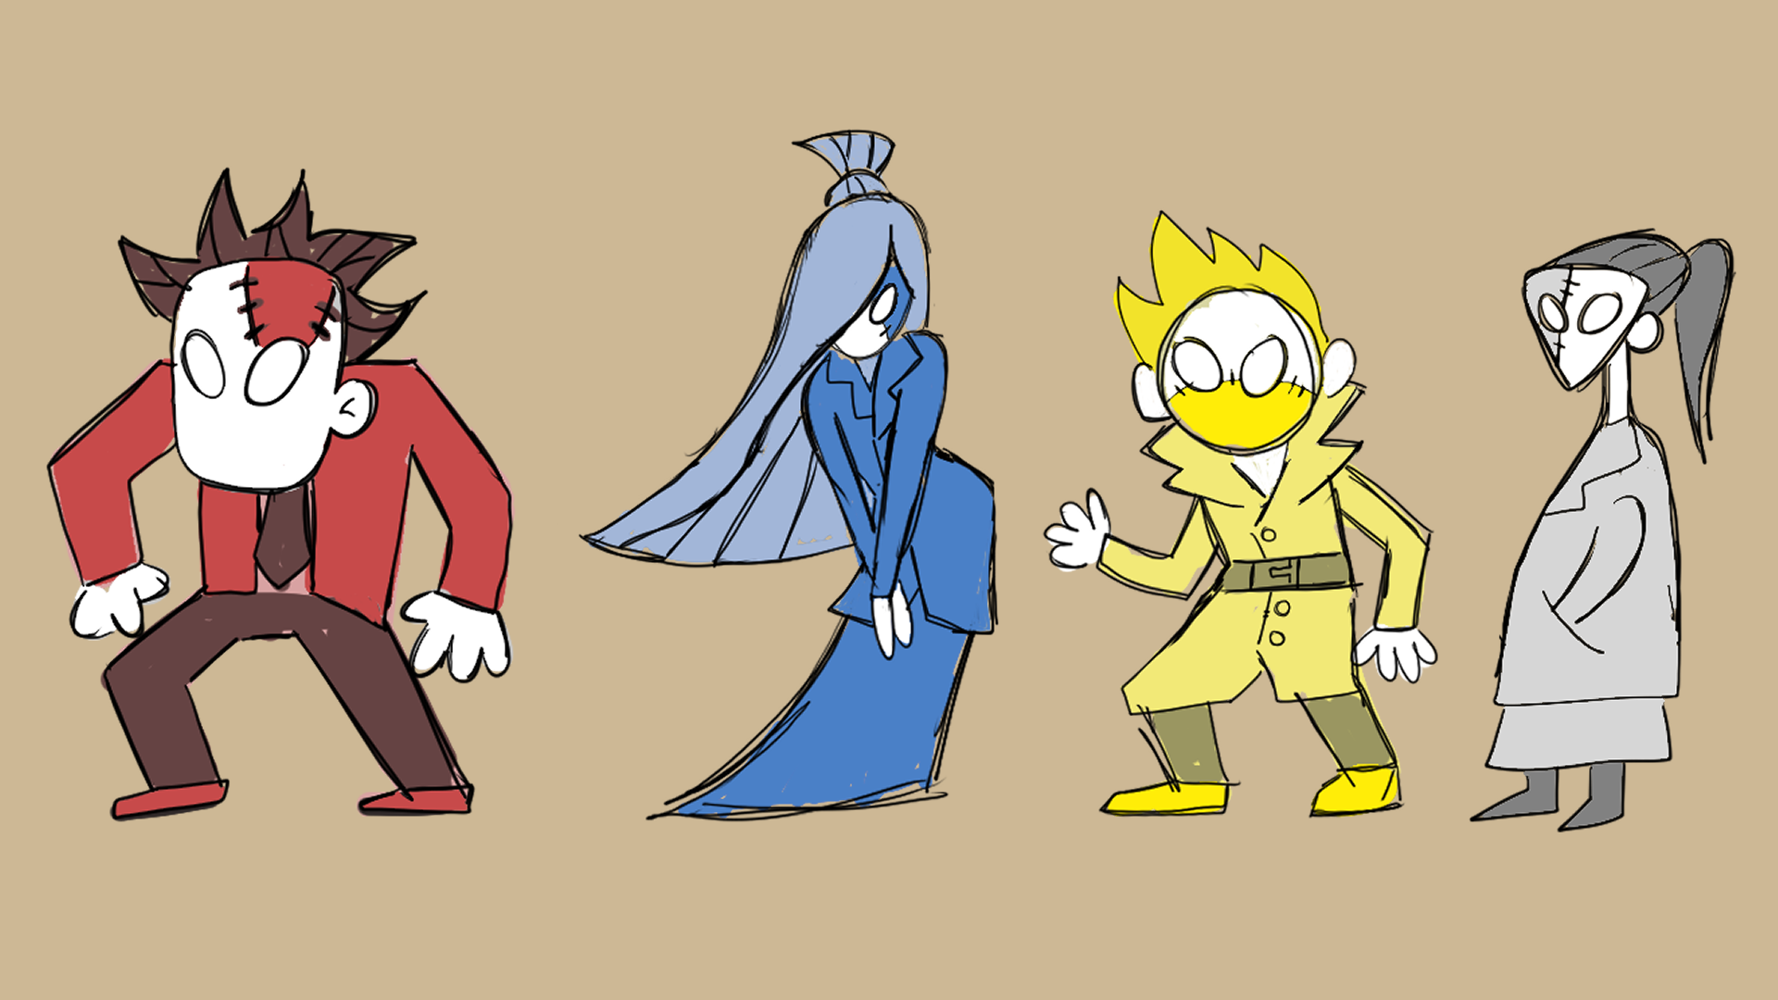
Characters
Red Character
Blue Character
Blazer
Square
CEO
Aggressive
Male
Suit
Circle
New Intern
happy/ bubbly
Woman
Yellow Character
White Character
Blazer
Triangle
Old desk clerk
Lazy, chill, lifeless
Male
Suit
Rectangle
Manager
Distant, cold
Woman

Slide 18
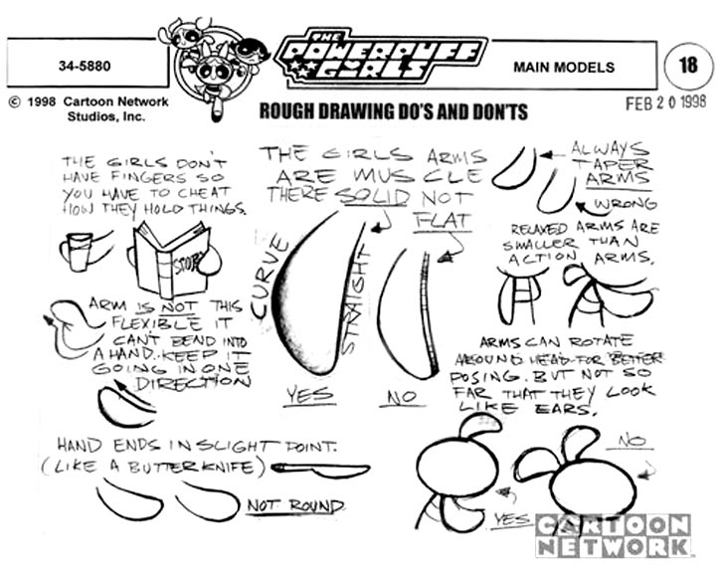
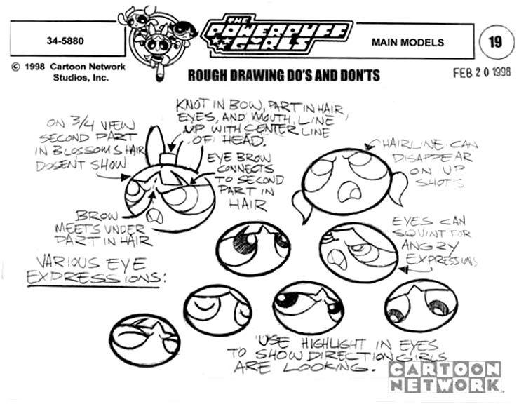
Do’s and Don’ts
Example:

Slide 19
Environment Design

Slide 20
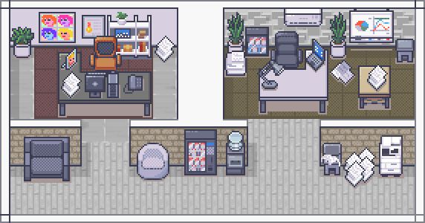
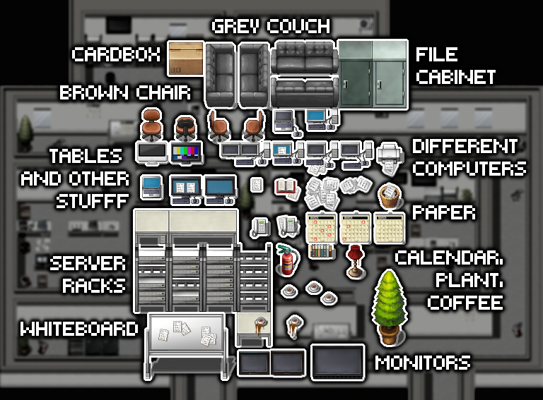
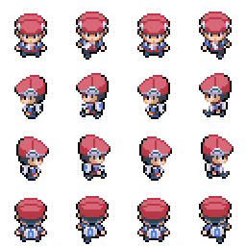
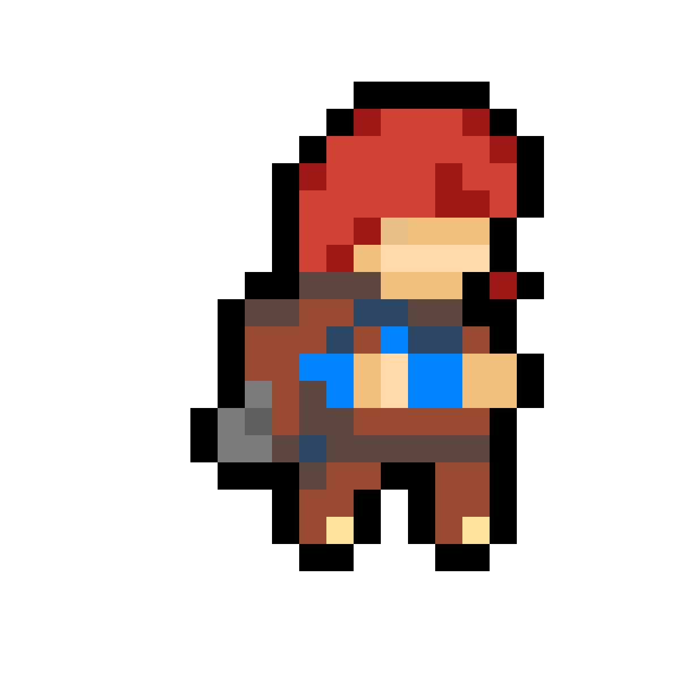
Moodboard

Slide 21
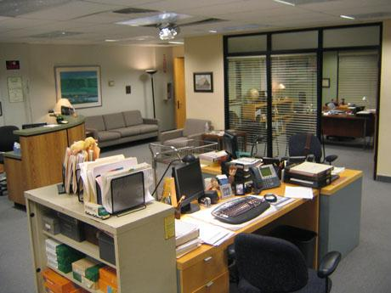
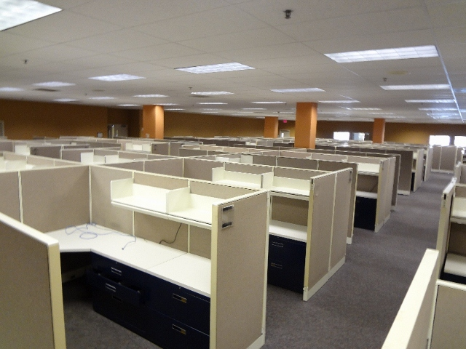
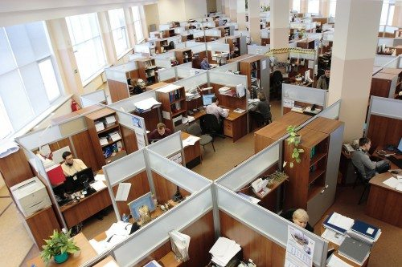
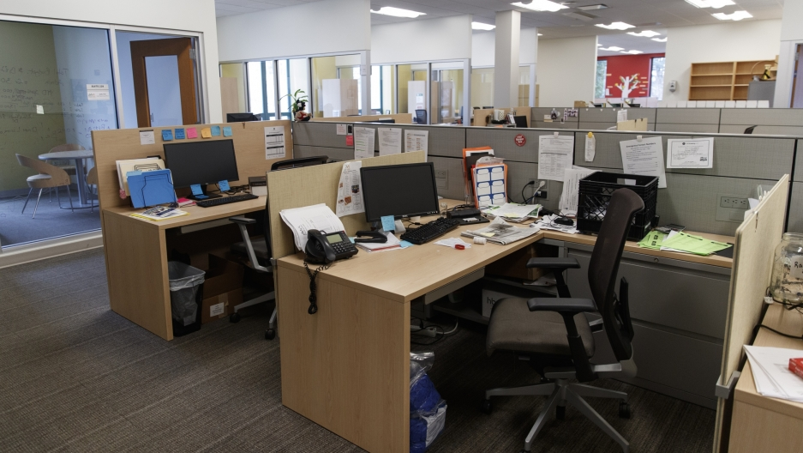
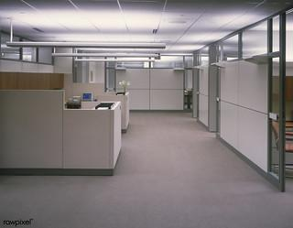
Reference Images
The setting of the game is an office building in which the characters navigate their daily life and tasks.

